Slide 1
Best practice of code review using Git/Gerrit

Slide 2
Agenda
Code Review案例学习
如何推广、实施Code Review
如何提高review质量

Slide 3
Case Study – Cisco/Collaborator
Code Review Case Study: Cisco Systems
提高代码review效率和积极性
团队5人，10月，2500 review，3200 KLOC
线下review
协作，方便交流
与bug系统集成 (我们是fisheye + jira)
直观、易用、高效

Slide 4
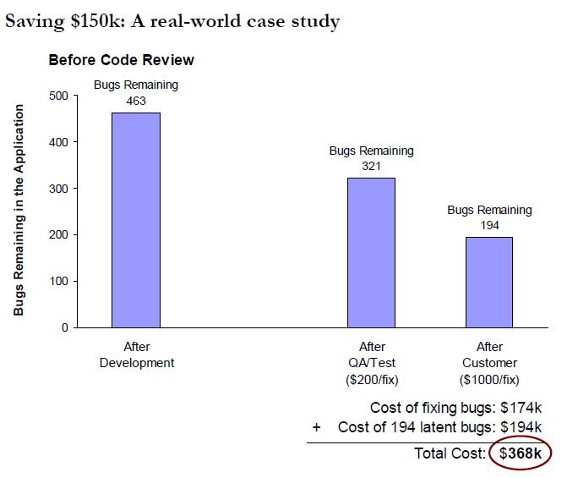
Before Code Review

Slide 5
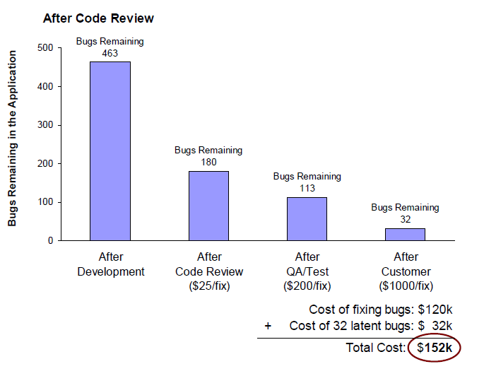
After Code Review

Slide 6
Agenda
Code Review案例学习
如何推广、实施Code Review
如何提高Code Review质量

Slide 7
大家都想要的
减少RCA、Bug
提高代码质量
提高开发水平
团队凝聚力
营造工程师文化
。。。
以前的codereview为何执行不下去？
工具不专业：XX项目请review，哪行改了不知道，自己去找
绩效难定义：缺少数据分析和KPI，没法监控，领导不好抓
各种形式的Codereview，没工具，没闭环。Review了，但代码没改

Slide 8
SMART Goal
SMART Codereview System
Specific 需要专业的工具。
Relevant 不影响开发效率的流程.
Achievable 容易操作，容易分享、容易整体提高效率
Measureable 可度量，可评测的KPI （提交85%，完成95%）
Time base 一定时间范围内的考核机制
首先转变和培养大部分Dev对代码质量的意思和重视度
以我们的经验，工具/流程/KPI最重要

Slide 9
酒店codereview经验分享
What&Why
Who
主管、经理 – 发现问题，最终负责人
不同的角色，review的目的可以不同
资深开发人员 – 发现问题
资深领域专家 – 发现问题
新人 - 学习、融入
架构师 - 确保设计被正确实现；检验设计是否有偏差
When
开发阶段，毫无疑问
Pre-commit/Post-commit改变的是review子流程，影响review的及时性和覆盖率，从而影响质量和效率，需要区别对待来推广
Where
Web, IDE看代码
面对面讨论代码
How
单人review – 简单case
多人review – 复杂case
Review meeting – 核心代码

Slide 10
Achievement
阶段成果：
2月试点与优化，5月开始酒店全面执行
已完成600万行，产生4000条comments
测试反馈：测试bug少了，代码质量有提高

Slide 11
Agenda
Code Review案例学习
如何推广、实施Code Review
如何提高Code Review质量

Slide 12
如何提高review质量
如何提高review质量
Code 质量
Comments质量
自动化预审核

Slide 13
代码质量指标
正确性
可编译
可读性
可维护性
可复用性

Slide 14
可读性
public SearchHotelDataResponse ProcessData(SearchHotelDataResponse searchHotelResponse, SearchHotelDataRequest searchHotelRequest, object status = null)
{
Stopwatch sw = null;
try
{
#region logic
if (ConfigurationTypeConst.EnableRoomTicketGiftsProcess())
{
sw = Stopwatch.StartNew();
string searchtype = searchHotelRequest.SearchTypeEntity.SearchType.ToString();
var RoomTicketGiftsDic = RoomTicketGiftsDataBusiness.Instance.GetAllDataFromNativeCache();
searchHotelResponse.HotelDataList.ForEach(hotelDataList =>
{
int city = hotelDataList.HotelStaticInfoEntity.HotelBaseInfoEntity.City;
int star = hotelDataList.HotelStaticInfoEntity.HotelBaseInfoEntity.Star;
Dictionary<int, List<int>> cityTicketIDDict = null;
Dictionary<int, List<int>> starTicketIDDict = null;
Dictionary<int, List<int>> typeTicketIDDict = null;
List<RoomTicketGifts> roomTicketGifts = null;
List<int> ticketIDsOfCity = null;
List<int> ticketIDsOfStar = null;
// 缓存中获取:送券规则字典
Dictionary<int, RoomTicketGiftRule> ticketRuleComponent = RoomTicketGiftRuleBusiness.Instance.GetAllDataFromNativeCache();
// 这个字典中如果有值的话，只可能有个Key=0，Value=Component。所以这里只取key=0的
if (ticketRuleComponent.Count == 1 && ticketRuleComponent.ContainsKey(0))
{
cityTicketIDDict = ticketRuleComponent[0].CityTicketIDDict;
starTicketIDDict = ticketRuleComponent[0].StarTicketIDDict;
typeTicketIDDict = ticketRuleComponent[0].TypeTicketIDDict;
roomTicketGifts = ticketRuleComponent[0].RoomTicketGifts;
if (cityTicketIDDict != null && cityTicketIDDict.ContainsKey(city))
{
ticketIDsOfCity = cityTicketIDDict[city];
}
if (starTicketIDDict != null && starTicketIDDict.ContainsKey(star))
{
ticketIDsOfStar = starTicketIDDict[star];
}
}
List<RoomTicketGifts> roomTicketGifts_temp = null;
if (RoomTicketGiftsDic != null && RoomTicketGiftsDic.Count > 0)
{
hotelDataList.BaseRoomEntity.ForEach(delegate(BaseRoomEntity baseRoomentity_temp)
{
baseRoomentity_temp.RoomDataEntity.ForEach(delegate(RoomDataEntity roomListEntity_temp)
{
// 是否是返现房型
bool IsHandBackCashRoomType = false; //返现房型(送券, 送游票, 券返, 直返)3
bool IsPrePayDiscountRoomType = roomListEntity_temp.RoomStatusEntity.PriceType == PriceType.PrePayDiscount;//预付立减房型 4
bool IsPP = roomListEntity_temp.RoomStatusEntity.PayType == PayType.PP; // 预付房型2
bool IsFG = roomListEntity_temp.RoomStatusEntity.PayType == PayType.FG; // 现付房型1
List<int> excludeTicketIDsOfType = new List<int>();
#region 得到要排除的ticketID
if (typeTicketIDDict != null && roomTicketGifts != null)
{
foreach (RoomTicketGifts gift in roomTicketGifts)
{
bool checkinAfterEnd = DateTime.Now.Date > gift.EndDate;
bool checkoutBeforeStart = DateTime.Now.Date < gift.StartDate;
bool weekdayMatch = CheckWeek(searchHotelRequest, gift.WeekDayIndex);
//bool paymentTypeMatch = string.IsNullOrEmpty(gift.PaymentType)?false:gift.PaymentType.Equals(roomListEntity_temp.RoomStatusEntity.PayType.ToString());
// 如果已过期，或者星期不匹配，或者支付方式不匹配
if (checkinAfterEnd || checkoutBeforeStart || !weekdayMatch)//|| !paymentTypeMatch
{
excludeTicketIDsOfType.Add(gift.RoomTicketGiftsID);
continue;
}
if (IsPrePayDiscountRoomType && typeTicketIDDict.ContainsKey(4))
{
if (typeTicketIDDict[4].Contains(gift.RoomTicketGiftsID))
{
excludeTicketIDsOfType.Add(gift.RoomTicketGiftsID);
continue;
}
}
if (IsPP && typeTicketIDDict.ContainsKey(2))
{
if (typeTicketIDDict[2].Contains(gift.RoomTicketGiftsID))
{
excludeTicketIDsOfType.Add(gift.RoomTicketGiftsID);
continue;
}
}
if (IsFG && typeTicketIDDict.ContainsKey(1))
{
if (typeTicketIDDict[1].Contains(gift.RoomTicketGiftsID))
{
excludeTicketIDsOfType.Add(gift.RoomTicketGiftsID);
continue;
}
}
}
}
#endregion
//只有取到了gift信息才进去处理
if (RoomTicketGiftsDic.TryGetValue(roomListEntity_temp.RoomStatusEntity.Room, out roomTicketGifts_temp))
{
List<RoomTicketGifts> roomTicketGifts_temps = new List<RoomTicketGifts>();
//判断筛选信息是否符合条件 活动循环
roomTicketGifts_temp.ForEach(delegate(RoomTicketGifts roomTicketGifts_temp1)
{
List<RoomTicketGiftsDetail> roomTicketGiftsDetailsList = new List<RoomTicketGiftsDetail>();
//明细循环
roomTicketGifts_temp1.RoomTicketGiftsDetail.ForEach(delegate(RoomTicketGiftsDetail roomTicketGiftsDetail_temp1)
{
if (!CheckWeek(searchHotelRequest, roomTicketGiftsDetail_temp1.WeekDayIndex) && string.Compare(roomTicketGiftsDetail_temp1.TicketType, "Y", StringComparison.OrdinalIgnoreCase) == 0)//星期不适用时不返回
{
return;
}
//日期判断
if (roomTicketGiftsDetail_temp1.Arrival < searchHotelRequest.PublicSearchParameter.CheckOutDate && roomTicketGiftsDetail_temp1.Departure >= searchHotelRequest.PublicSearchParameter.CheckInDate && DateTime.Now.Date >= roomTicketGiftsDetail_temp1.StartDate && DateTime.Now.Date <= roomTicketGiftsDetail_temp1.EndDate)
{
if (searchHotelRequest.SearchTypeEntity.SearchType == SearchType.PkgResSearch)//度假送券不判支付类型
{
if (string.Equals(roomTicketGiftsDetail_temp1.PaymentType, "FP", StringComparison.OrdinalIgnoreCase)
|| (roomListEntity_temp.RoomStatusEntity.IsFGToPP && string.Equals(roomTicketGiftsDetail_temp1.PaymentType, "FG", StringComparison.OrdinalIgnoreCase))
|| string.Equals(roomTicketGiftsDetail_temp1.PaymentType, roomListEntity_temp.RoomStatusEntity.PayType.ToString(), StringComparison.OrdinalIgnoreCase))
{
RoomTicketGiftsDetail roomTicketGiftsDetail_tempCopy = roomTicketGiftsDetail_temp1.Clone() as RoomTicketGiftsDetail;
roomTicketGiftsDetail_tempCopy.CalculateAmount = GetRoomTicketgiftsCalculateAmount(roomTicketGiftsDetail_tempCopy, roomListEntity_temp, searchHotelRequest.SearchTypeEntity.IntlCity, searchHotelRequest.PublicSearchParameter.IgnoreExchange);
AddTicketGiftsDetailWithWirelessChecking(roomTicketGiftsDetailsList, roomTicketGiftsDetail_tempCopy, searchHotelRequest);
// 如果是false，说明房型目前还没有返现，需要判断。如果是true，说明房型已有返现，不需要再判断了
if (!IsHandBackCashRoomType)
{
// Y是平台券,非平台券既是 返现券
IsHandBackCashRoomType = roomTicketGiftsDetail_tempCopy.TicketType != "Y";
}
}
}
else
{
if (searchHotelRequest.PublicSearchParameter.IsRequestTravelMoney
&& (searchHotelRequest.SearchTypeEntity.SearchType == SearchType.OnLineSearch)
&& string.Compare(roomTicketGiftsDetail_temp1.TicketType, "Y", StringComparison.OrdinalIgnoreCase) == 0
&& roomListEntity_temp.RoomStatusEntity.PayType == PayType.FG
&& (roomTicketGiftsDetail_temp1.PaymentType == "FP" || roomTicketGiftsDetail_temp1.PaymentType == "PP")
)
{
RoomTicketGiftsDetail roomTicketGiftsDetail_tempCopy = roomTicketGiftsDetail_temp1.Clone() as RoomTicketGiftsDetail;
roomTicketGiftsDetail_tempCopy.CalculateAmount = GetRoomTicketgiftsCalculateAmount(roomTicketGiftsDetail_tempCopy, roomListEntity_temp, searchHotelRequest.SearchTypeEntity.IntlCity, searchHotelRequest.PublicSearchParameter.IgnoreExchange);
AddTicketGiftsDetailWithWirelessChecking(roomTicketGiftsDetailsList, roomTicketGiftsDetail_tempCopy, searchHotelRequest);
// 如果是false，说明房型目前还没有返现，需要判断。如果是true，说明房型已有返现，不需要再判断了
if (!IsHandBackCashRoomType)
{
// Y是平台券,非平台券既是 返现券
IsHandBackCashRoomType = roomTicketGiftsDetail_tempCopy.TicketType != "Y";
}
}
else if (roomTicketGiftsDetail_temp1.PaymentType == "FP" || string.Compare(roomTicketGiftsDetail_temp1.PaymentType.Trim(), roomListEntity_temp.RoomStatusEntity.PayType.ToString(), StringComparison.OrdinalIgnoreCase) == 0)
{
RoomTicketGiftsDetail roomTicketGiftsDetail_tempCopy = roomTicketGiftsDetail_temp1.Clone() as RoomTicketGiftsDetail;
roomTicketGiftsDetail_tempCopy.CalculateAmount = GetRoomTicketgiftsCalculateAmount(roomTicketGiftsDetail_tempCopy, roomListEntity_temp, searchHotelRequest.SearchTypeEntity.IntlCity, searchHotelRequest.PublicSearchParameter.IgnoreExchange);
AddTicketGiftsDetailWithWirelessChecking(roomTicketGiftsDetailsList, roomTicketGiftsDetail_tempCopy, searchHotelRequest);
// 如果是false，说明房型目前还没有返现，需要判断。如果是true，说明房型已有返现，不需要再判断了
if (!IsHandBackCashRoomType)
{
// Y是平台券,非平台券既是 返现券
IsHandBackCashRoomType = roomTicketGiftsDetail_tempCopy.TicketType != "Y";
}
}
}
}
});
if (roomTicketGiftsDetailsList.Count > 0)
{
RoomTicketGifts roomTicketgifts = new RoomTicketGifts();
roomTicketgifts.PlatformPromotionID = roomTicketGifts_temp1.PlatformPromotionID;
roomTicketgifts.RoomTicketGiftsID = roomTicketGifts_temp1.RoomTicketGiftsID;
roomTicketgifts.RoomTicketGiftsName = roomTicketGifts_temp1.RoomTicketGiftsName;
roomTicketgifts.TicketGiftsChannels = roomTicketGifts_temp1.TicketGiftsChannels;
roomTicketgifts.RoomTicketGiftsRealID = roomTicketGifts_temp1.RoomTicketGiftsRealID;
roomTicketgifts.RoomTicketGiftsDetail = roomTicketGiftsDetailsList;
roomTicketGifts_temps.Add(roomTicketgifts);
}
});
#region 追加新的送券rule 1.2 到房型
if (ConfigurationTypeConst.TicketGiftRuleSearchType().Contains(searchtype) && roomTicketGifts != null)
{
// 先循环一遍，添加排除项
foreach (RoomTicketGifts gift in roomTicketGifts)
{
if (IsHandBackCashRoomType && typeTicketIDDict.ContainsKey(3))
{
if (typeTicketIDDict[3].Contains(gift.RoomTicketGiftsID))
{
excludeTicketIDsOfType.Add(gift.RoomTicketGiftsID);
continue;
}
}
}
// 验证规则是否完全匹配，匹配的话添加
foreach (RoomTicketGifts gift in roomTicketGifts)
{
if (ticketIDsOfCity != null && ticketIDsOfStar != null)
{
bool cityMatch = ticketIDsOfCity.Contains(gift.RoomTicketGiftsID);
bool starMatch = ticketIDsOfStar.Contains(gift.RoomTicketGiftsID);
bool typeMatch = !excludeTicketIDsOfType.Contains(gift.RoomTicketGiftsID);
if (cityMatch && starMatch && typeMatch)
{
if (roomTicketGifts_temps.Find(e => e.RoomTicketGiftsID == gift.RoomTicketGiftsID) == null)
{
roomTicketGifts_temps.Add(gift);
}
}
}
}
}
#endregion
//送券信息赋值
roomListEntity_temp.RoomStaticInfoEntity.RoomTicketGifts = roomTicketGifts_temps;
}
else // 如果这个房型原来还没有关联任何ticket
{
if (ConfigurationTypeConst.TicketGiftRuleSearchType().Contains(searchtype) && roomTicketGifts != null)
{
List<RoomTicketGifts> roomTicketGifts_temps = new List<RoomTicketGifts>();
if (roomTicketGifts != null)
{
foreach (RoomTicketGifts gift in roomTicketGifts)
{
if (ticketIDsOfCity != null && ticketIDsOfStar != null)
{
bool cityMatch = ticketIDsOfCity.Contains(gift.RoomTicketGiftsID);
bool starMatch = ticketIDsOfStar.Contains(gift.RoomTicketGiftsID);
bool typeMatch = !excludeTicketIDsOfType.Contains(gift.RoomTicketGiftsID);
if (cityMatch && starMatch && typeMatch)
{
if (roomTicketGifts_temps.Find(e => e.RoomTicketGiftsID == gift.RoomTicketGiftsID) == null)
{
roomTicketGifts_temps.Add((RoomTicketGifts)gift.Clone());
}
}
}
}
}
roomListEntity_temp.RoomStaticInfoEntity.RoomTicketGifts = roomTicketGifts_temps;
}
}
});
});
}
});
}
#endregion
}
catch (Exception ex)
{
HelpBusiness.Logger.Error("RoomTicketGiftsProcess",
"RoomTicketGiftsProcess" + "\n" +
ex.Message + "\n" + ex.StackTrace + "\n"
+ (searchHotelRequest.Status is ShareStatus ? (searchHotelRequest.Status as ShareStatus).RawRequest : "null raw request"),
addinfo);
searchHotelResponse= new SearchHotelDataResponse();
}
finally
{
if (sw != null)
{
sw.Stop();
PerformanceDataRecorderUtility.AddOrUpdate("RoomTicketGiftsProcess", sw.ElapsedMilliseconds);
}
}
searchHotelResponse.DebugEntity.RoomTicketGiftsProcessTime = Math.Round(sw.Elapsed.TotalSeconds, 6);
return searchHotelResponse;
}
public SearchHotelDataResponse ProcessData(SearchHotelDataResponse searchHotelResponse, SearchHotelDataRequest searchHotelRequest, object status = null)
{
Stopwatch sw = null;
try
{
#region logic
if (ConfigurationTypeConst.EnableRoomTicketGiftsProcess())
{
sw = Stopwatch.StartNew();
string searchtype = searchHotelRequest.SearchTypeEntity.SearchType.ToString();
var RoomTicketGiftsDic = RoomTicketGiftsDataBusiness.Instance.GetAllDataFromNativeCache();
searchHotelResponse.HotelDataList.ForEach(hotelDataList =>
{
int city = hotelDataList.HotelStaticInfoEntity.HotelBaseInfoEntity.City;
int star = hotelDataList.HotelStaticInfoEntity.HotelBaseInfoEntity.Star;
Dictionary<int, List<int>> cityTicketIDDict = null;
Dictionary<int, List<int>> starTicketIDDict = null;
Dictionary<int, List<int>> typeTicketIDDict = null;
List<RoomTicketGifts> roomTicketGifts = null;
……………….

Slide 15
可读性
}
#endregion
}
catch (Exception ex)
{
HelpBusiness.Logger.Error("RoomTicketGiftsProcess",
"RoomTicketGiftsProcess" + "\n" +
ex.Message + "\n" + ex.StackTrace + "\n"
+ (searchHotelRequest.Status is ShareStatus ? (searchHotelRequest.Status as ShareStatus).RawRequest : "null raw request"),
addinfo);
searchHotelResponse= new SearchHotelDataResponse();
}
finally
{
if (sw != null)
{
sw.Stop();
PerformanceDataRecorderUtility.AddOrUpdate("RoomTicketGiftsProcess", sw.ElapsedMilliseconds);
}
}
searchHotelResponse.DebugEntity.RoomTicketGiftsProcessTime = Math.Round(sw.Elapsed.TotalSeconds, 6);
return searchHotelResponse;
}
可读性差而没有发现问题

Slide 16
可读性
public SearchHotelDataResponse ProcessData(SearchHotelDataResponse searchHotelResponse, SearchHotelDataRequest searchHotelRequest, object status = null)
{
Stopwatch sw = null;
try
{
#region logic
if (ConfigurationTypeConst.EnableRoomTicketGiftsProcess())
{
sw = Stopwatch.StartNew();
string searchtype = searchHotelRequest.SearchTypeEntity.SearchType.ToString();
var RoomTicketGiftsDic = RoomTicketGiftsDataBusiness.Instance.GetAllDataFromNativeCache();
searchHotelResponse.HotelDataList.ForEach(hotelDataList =>
{
int city = hotelDataList.HotelStaticInfoEntity.HotelBaseInfoEntity.City;
int star = hotelDataList.HotelStaticInfoEntity.HotelBaseInfoEntity.Star;
Dictionary<int, List<int>> cityTicketIDDict = null;
Dictionary<int, List<int>> starTicketIDDict = null;
Dictionary<int, List<int>> typeTicketIDDict = null;
List<RoomTicketGifts> roomTicketGifts = null;
List<int> ticketIDsOfCity = null;
List<int> ticketIDsOfStar = null;
// 缓存中获取:送券规则字典
Dictionary<int, RoomTicketGiftRule> ticketRuleComponent = RoomTicketGiftRuleBusiness.Instance.GetAllDataFromNativeCache();
// 这个字典中如果有值的话，只可能有个Key=0，Value=Component。所以这里只取key=0的
if (ticketRuleComponent.Count == 1 && ticketRuleComponent.ContainsKey(0))
{
cityTicketIDDict = ticketRuleComponent[0].CityTicketIDDict;
starTicketIDDict = ticketRuleComponent[0].StarTicketIDDict;
typeTicketIDDict = ticketRuleComponent[0].TypeTicketIDDict;
roomTicketGifts = ticketRuleComponent[0].RoomTicketGifts;
if (cityTicketIDDict != null && cityTicketIDDict.ContainsKey(city))
{
ticketIDsOfCity = cityTicketIDDict[city];
}
if (starTicketIDDict != null && starTicketIDDict.ContainsKey(star))
{
ticketIDsOfStar = starTicketIDDict[star];
}
}
List<RoomTicketGifts> roomTicketGifts_temp = null;
if (RoomTicketGiftsDic != null && RoomTicketGiftsDic.Count > 0)
{
hotelDataList.BaseRoomEntity.ForEach(delegate(BaseRoomEntity baseRoomentity_temp)
{
baseRoomentity_temp.RoomDataEntity.ForEach(delegate(RoomDataEntity roomListEntity_temp)
{
// 是否是返现房型
bool IsHandBackCashRoomType = false; //返现房型(送券, 送游票, 券返, 直返)3
bool IsPrePayDiscountRoomType = roomListEntity_temp.RoomStatusEntity.PriceType == PriceType.PrePayDiscount;//预付立减房型 4
bool IsPP = roomListEntity_temp.RoomStatusEntity.PayType == PayType.PP; // 预付房型2
bool IsFG = roomListEntity_temp.RoomStatusEntity.PayType == PayType.FG; // 现付房型1
List<int> excludeTicketIDsOfType = new List<int>();
#region 得到要排除的ticketID
if (typeTicketIDDict != null && roomTicketGifts != null)
{
foreach (RoomTicketGifts gift in roomTicketGifts)
{
bool checkinAfterEnd = DateTime.Now.Date > gift.EndDate;
bool checkoutBeforeStart = DateTime.Now.Date < gift.StartDate;
bool weekdayMatch = CheckWeek(searchHotelRequest, gift.WeekDayIndex);
//bool paymentTypeMatch = string.IsNullOrEmpty(gift.PaymentType)?false:gift.PaymentType.Equals(roomListEntity_temp.RoomStatusEntity.PayType.ToString());
// 如果已过期，或者星期不匹配，或者支付方式不匹配
if (checkinAfterEnd || checkoutBeforeStart || !weekdayMatch)//|| !paymentTypeMatch
{
excludeTicketIDsOfType.Add(gift.RoomTicketGiftsID);
continue;
}
if (IsPrePayDiscountRoomType && typeTicketIDDict.ContainsKey(4))
{
if (typeTicketIDDict[4].Contains(gift.RoomTicketGiftsID))
{
excludeTicketIDsOfType.Add(gift.RoomTicketGiftsID);
continue;
}
}
if (IsPP && typeTicketIDDict.ContainsKey(2))
{
if (typeTicketIDDict[2].Contains(gift.RoomTicketGiftsID))
{
excludeTicketIDsOfType.Add(gift.RoomTicketGiftsID);
continue;
}
}
if (IsFG && typeTicketIDDict.ContainsKey(1))
{
if (typeTicketIDDict[1].Contains(gift.RoomTicketGiftsID))
{
excludeTicketIDsOfType.Add(gift.RoomTicketGiftsID);
continue;
}
}
}
}
#endregion
//只有取到了gift信息才进去处理
if (RoomTicketGiftsDic.TryGetValue(roomListEntity_temp.RoomStatusEntity.Room, out roomTicketGifts_temp))
{
List<RoomTicketGifts> roomTicketGifts_temps = new List<RoomTicketGifts>();
//判断筛选信息是否符合条件 活动循环
roomTicketGifts_temp.ForEach(delegate(RoomTicketGifts roomTicketGifts_temp1)
{
List<RoomTicketGiftsDetail> roomTicketGiftsDetailsList = new List<RoomTicketGiftsDetail>();
//明细循环
roomTicketGifts_temp1.RoomTicketGiftsDetail.ForEach(delegate(RoomTicketGiftsDetail roomTicketGiftsDetail_temp1)
{
if (!CheckWeek(searchHotelRequest, roomTicketGiftsDetail_temp1.WeekDayIndex) && string.Compare(roomTicketGiftsDetail_temp1.TicketType, "Y", StringComparison.OrdinalIgnoreCase) == 0)//星期不适用时不返回
{
return;
}
//日期判断
if (roomTicketGiftsDetail_temp1.Arrival < searchHotelRequest.PublicSearchParameter.CheckOutDate && roomTicketGiftsDetail_temp1.Departure >= searchHotelRequest.PublicSearchParameter.CheckInDate && DateTime.Now.Date >= roomTicketGiftsDetail_temp1.StartDate && DateTime.Now.Date <= roomTicketGiftsDetail_temp1.EndDate)
{
if (searchHotelRequest.SearchTypeEntity.SearchType == SearchType.PkgResSearch)//度假送券不判支付类型
{
if (string.Equals(roomTicketGiftsDetail_temp1.PaymentType, "FP", StringComparison.OrdinalIgnoreCase)
|| (roomListEntity_temp.RoomStatusEntity.IsFGToPP && string.Equals(roomTicketGiftsDetail_temp1.PaymentType, "FG", StringComparison.OrdinalIgnoreCase))
|| string.Equals(roomTicketGiftsDetail_temp1.PaymentType, roomListEntity_temp.RoomStatusEntity.PayType.ToString(), StringComparison.OrdinalIgnoreCase))
{
RoomTicketGiftsDetail roomTicketGiftsDetail_tempCopy = roomTicketGiftsDetail_temp1.Clone() as RoomTicketGiftsDetail;
roomTicketGiftsDetail_tempCopy.CalculateAmount = GetRoomTicketgiftsCalculateAmount(roomTicketGiftsDetail_tempCopy, roomListEntity_temp, searchHotelRequest.SearchTypeEntity.IntlCity, searchHotelRequest.PublicSearchParameter.IgnoreExchange);
AddTicketGiftsDetailWithWirelessChecking(roomTicketGiftsDetailsList, roomTicketGiftsDetail_tempCopy, searchHotelRequest);
// 如果是false，说明房型目前还没有返现，需要判断。如果是true，说明房型已有返现，不需要再判断了
if (!IsHandBackCashRoomType)
{
// Y是平台券,非平台券既是 返现券
IsHandBackCashRoomType = roomTicketGiftsDetail_tempCopy.TicketType != "Y";
}
}
}
else
{
if (searchHotelRequest.PublicSearchParameter.IsRequestTravelMoney
&& (searchHotelRequest.SearchTypeEntity.SearchType == SearchType.OnLineSearch)
&& string.Compare(roomTicketGiftsDetail_temp1.TicketType, "Y", StringComparison.OrdinalIgnoreCase) == 0
&& roomListEntity_temp.RoomStatusEntity.PayType == PayType.FG
&& (roomTicketGiftsDetail_temp1.PaymentType == "FP" || roomTicketGiftsDetail_temp1.PaymentType == "PP")
)
{
RoomTicketGiftsDetail roomTicketGiftsDetail_tempCopy = roomTicketGiftsDetail_temp1.Clone() as RoomTicketGiftsDetail;
roomTicketGiftsDetail_tempCopy.CalculateAmount = GetRoomTicketgiftsCalculateAmount(roomTicketGiftsDetail_tempCopy, roomListEntity_temp, searchHotelRequest.SearchTypeEntity.IntlCity, searchHotelRequest.PublicSearchParameter.IgnoreExchange);
AddTicketGiftsDetailWithWirelessChecking(roomTicketGiftsDetailsList, roomTicketGiftsDetail_tempCopy, searchHotelRequest);
// 如果是false，说明房型目前还没有返现，需要判断。如果是true，说明房型已有返现，不需要再判断了
if (!IsHandBackCashRoomType)
{
// Y是平台券,非平台券既是 返现券
IsHandBackCashRoomType = roomTicketGiftsDetail_tempCopy.TicketType != "Y";
}
}
else if (roomTicketGiftsDetail_temp1.PaymentType == "FP" || string.Compare(roomTicketGiftsDetail_temp1.PaymentType.Trim(), roomListEntity_temp.RoomStatusEntity.PayType.ToString(), StringComparison.OrdinalIgnoreCase) == 0)
{
RoomTicketGiftsDetail roomTicketGiftsDetail_tempCopy = roomTicketGiftsDetail_temp1.Clone() as RoomTicketGiftsDetail;
roomTicketGiftsDetail_tempCopy.CalculateAmount = GetRoomTicketgiftsCalculateAmount(roomTicketGiftsDetail_tempCopy, roomListEntity_temp, searchHotelRequest.SearchTypeEntity.IntlCity, searchHotelRequest.PublicSearchParameter.IgnoreExchange);
AddTicketGiftsDetailWithWirelessChecking(roomTicketGiftsDetailsList, roomTicketGiftsDetail_tempCopy, searchHotelRequest);
// 如果是false，说明房型目前还没有返现，需要判断。如果是true，说明房型已有返现，不需要再判断了
if (!IsHandBackCashRoomType)
{
// Y是平台券,非平台券既是 返现券
IsHandBackCashRoomType = roomTicketGiftsDetail_tempCopy.TicketType != "Y";
}
}
}
}
});
if (roomTicketGiftsDetailsList.Count > 0)
{
RoomTicketGifts roomTicketgifts = new RoomTicketGifts();
roomTicketgifts.PlatformPromotionID = roomTicketGifts_temp1.PlatformPromotionID;
roomTicketgifts.RoomTicketGiftsID = roomTicketGifts_temp1.RoomTicketGiftsID;
roomTicketgifts.RoomTicketGiftsName = roomTicketGifts_temp1.RoomTicketGiftsName;
roomTicketgifts.TicketGiftsChannels = roomTicketGifts_temp1.TicketGiftsChannels;
roomTicketgifts.RoomTicketGiftsRealID = roomTicketGifts_temp1.RoomTicketGiftsRealID;
roomTicketgifts.RoomTicketGiftsDetail = roomTicketGiftsDetailsList;
roomTicketGifts_temps.Add(roomTicketgifts);
}
});
#region 追加新的送券rule 1.2 到房型
if (ConfigurationTypeConst.TicketGiftRuleSearchType().Contains(searchtype) && roomTicketGifts != null)
{
// 先循环一遍，添加排除项
foreach (RoomTicketGifts gift in roomTicketGifts)
{
if (IsHandBackCashRoomType && typeTicketIDDict.ContainsKey(3))
{
if (typeTicketIDDict[3].Contains(gift.RoomTicketGiftsID))
{
excludeTicketIDsOfType.Add(gift.RoomTicketGiftsID);
continue;
}
}
}
// 验证规则是否完全匹配，匹配的话添加
foreach (RoomTicketGifts gift in roomTicketGifts)
{
if (ticketIDsOfCity != null && ticketIDsOfStar != null)
{
bool cityMatch = ticketIDsOfCity.Contains(gift.RoomTicketGiftsID);
bool starMatch = ticketIDsOfStar.Contains(gift.RoomTicketGiftsID);
bool typeMatch = !excludeTicketIDsOfType.Contains(gift.RoomTicketGiftsID);
if (cityMatch && starMatch && typeMatch)
{
if (roomTicketGifts_temps.Find(e => e.RoomTicketGiftsID == gift.RoomTicketGiftsID) == null)
{
roomTicketGifts_temps.Add(gift);
}
}
}
}
}
#endregion
//送券信息赋值
roomListEntity_temp.RoomStaticInfoEntity.RoomTicketGifts = roomTicketGifts_temps;
}
else // 如果这个房型原来还没有关联任何ticket
{
if (ConfigurationTypeConst.TicketGiftRuleSearchType().Contains(searchtype) && roomTicketGifts != null)
{
List<RoomTicketGifts> roomTicketGifts_temps = new List<RoomTicketGifts>();
if (roomTicketGifts != null)
{
foreach (RoomTicketGifts gift in roomTicketGifts)
{
if (ticketIDsOfCity != null && ticketIDsOfStar != null)
{
bool cityMatch = ticketIDsOfCity.Contains(gift.RoomTicketGiftsID);
bool starMatch = ticketIDsOfStar.Contains(gift.RoomTicketGiftsID);
bool typeMatch = !excludeTicketIDsOfType.Contains(gift.RoomTicketGiftsID);
if (cityMatch && starMatch && typeMatch)
{
if (roomTicketGifts_temps.Find(e => e.RoomTicketGiftsID == gift.RoomTicketGiftsID) == null)
{
roomTicketGifts_temps.Add((RoomTicketGifts)gift.Clone());
}
}
}
}
}
roomListEntity_temp.RoomStaticInfoEntity.RoomTicketGifts = roomTicketGifts_temps;
}
}
});
});
}
});
}
#endregion
}
catch (Exception ex)
{
HelpBusiness.Logger.Error("RoomTicketGiftsProcess",
"RoomTicketGiftsProcess" + "\n" +
ex.Message + "\n" + ex.StackTrace + "\n"
+ (searchHotelRequest.Status is ShareStatus ? (searchHotelRequest.Status as ShareStatus).RawRequest : "null raw request"),
addinfo);
searchHotelResponse= new SearchHotelDataResponse();
}
finally
{
if (sw != null)
{
sw.Stop();
PerformanceDataRecorderUtility.AddOrUpdate("RoomTicketGiftsProcess", sw.ElapsedMilliseconds);
}
}
searchHotelResponse.DebugEntity.RoomTicketGiftsProcessTime = Math.Round(sw.Elapsed.TotalSeconds, 6);
return searchHotelResponse;
}
public SearchHotelDataResponse ProcessData(SearchHotelDataResponse searchHotelResponse, SearchHotelDataRequest searchHotelRequest, object status = null)
{
Stopwatch sw = null;
try
{
#region logic
if (ConfigurationTypeConst.EnableRoomTicketGiftsProcess())
{
sw = Stopwatch.StartNew();
……………….
}
catch (Exception ex)
{
……………….
}
finally
{
if (sw != null)
{
sw.Stop();
PerformanceDataRecorderUtility.AddOrUpdate("RoomTicketGiftsProcess", sw.ElapsedMilliseconds);
}
}
searchHotelResponse.DebugEntity.RoomTicketGiftsProcessTime = Math.Round(sw.Elapsed.TotalSeconds, 6);
return searchHotelResponse;
}

Slide 17
可维护性
Don't be STUPID: GRASP SOLID!

Slide 18
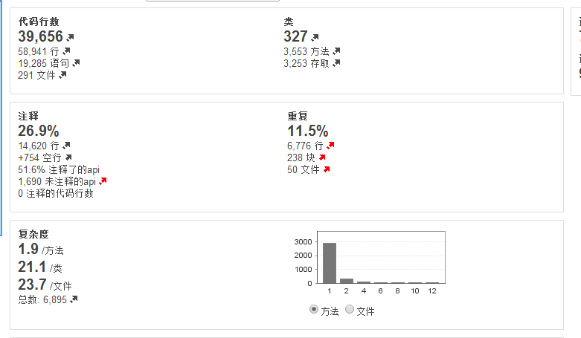
代码质量指标的衡量
现有的一些指标
覆盖率、完成率 只是为了监督大家去做，档次还很低；
Comments率只是为了监督大家认真的去做，还是无法衡量可重用、可维护
Bug率，冒烟测试第一轮通过率，这完全是衡量正确性的标准
若要衡量代码可维护、可重用，需要代码分析工具，做 注释率、重复率、复杂度的计算，可以作为可维护性、可重用性的衡量指标。
平均每个类11个方法，显多了
API注释率51.6，注释不够，特别是api级别
代码重复11.5%
复杂度计算，这个待研究

Slide 19
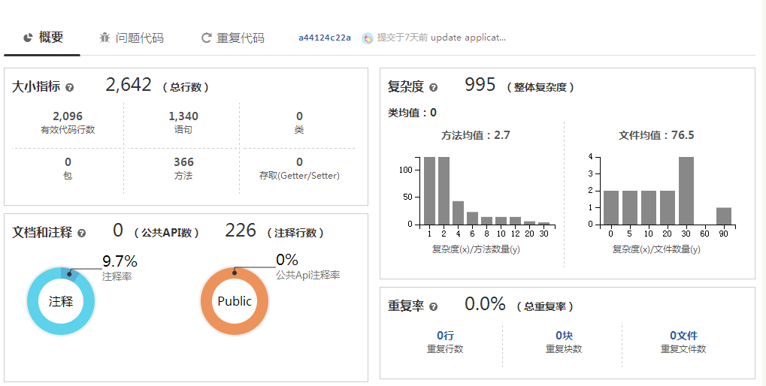
一些工具研究
FXCOP / Sonar/Coding.net/ MSDN…

Slide 20
提高Code review质量
Comment report
统计（comments/per KLOC），目前<1/KLOC，太少，期望达到7-8 /KLOC
判断优秀comment的标准：提高复用 > 提高可维护 > 提高正确性 > 提高可读
优秀的comment怎么来？good comment – knowledge share – 提升能力 – better comment 周而复始，良性循环
按组织架构出Comments report
check list
建立check list的目的是为了培训、辅助大家怎么去review
部门级checklist -> 小组级checklist -> review级checklist，从而保证code review最低质量
Check list的目的是为了培训review新手，逐渐熟悉后应该淡忘check list，回归通过交流来完成review（这时的交流技术等级应该比较高）
Knowledge share
各种Comment经验集中到一本doc中，并做相应归类，即方便查找，又有利于知识系统化（类似effective C++/java文档）
每周四的workshop会议10分钟讲一下实践的分享（按需）
做一些软件开发技术的知识分享

Slide 21
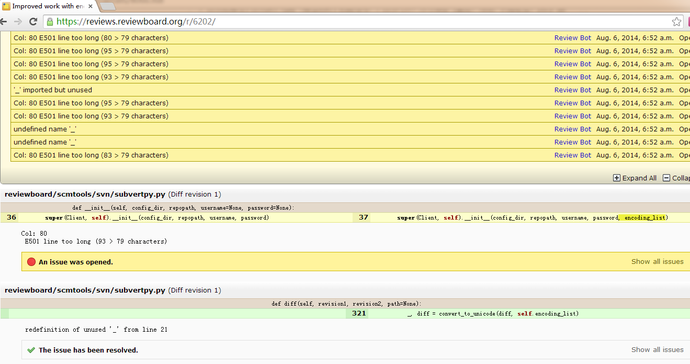
自动审核

Slide 22
Thanks

